Slide 1

Dipak Kumar Pal (dipakpal.opentech@gmail.com)
PGP SupportPac v1.0.0.2
for
IBM Integration Bus v9

Slide 2
Problem Statement:
Limited security facilities in IBM Integration Bus
Security facilities offered by IBM Integration Bus
Security facilities in IBM Integration Bus are typically based on
Websphere MQ security.
Transport layer security (e.g. SSL/TLS) provided by underlying transport mechanism.
Access Controls (e.g. Authentication and Authorization) mechanism powered by internal (broker’s security manager) and external security providers (e.g. WS-Trust v1.3 compliant security token servers, Tivoli Federated Identity Manager, Lightweight Directory Access Protocol)
WS-Security for Web Services using SOAP nodes.
PGP SupportPac version 1.0.0.2 for IBM Integration Bus v9

Slide 3
Problem Statement (continue……):
Limited security facilities in IBM Integration Bus
Limitation in security features offered by IBM Integration Bus
Webservice technology is not considered as a preferred solution in today’s enterprise integration world for asynchronous and one-way data communication especially while dealing with large volume of data communication and data transfer in batch mode. In this scenario WS-Security standard can not be applied.
Use of SSL at transport layer slows down overall transfer rate as it encrypts the entire traffic. Use of SSL can be eliminated while transferring data over trusted network (e.g. Intranet) by encrypting only sensitive and confidential information at application layer itself.
External applications (e.g. third party vendors, customers, government agencies) often ask for data encryption before transferring to/from them, even if SSL is used at transport layer.
PGP SupportPac version 1.0.0.2 for IBM Integration Bus v9

Slide 4
Problem Statement (continue……):
Limited security facilities in IBM Integration Bus
Limitation in security features offered by IBM Integration Bus
Apart from WS-Security standard (which is applicable for Webservices only), IBM Integration Bus does not provide any in-built solution for data security enforcing data confidentiality (Encryption) and integrity (Digital Signature).
Many organizations use various third party softwares/tools for implementing data security. But those third party softwares/tools are completely decoupled from IBM Integration Bus.
Why to use such third party softwares/tools at Integration Layer if IBM Integration Bus provides a solution.
PGP SupportPac version 1.0.0.2 for IBM Integration Bus v9

Slide 5
Solution (PGP)
Solution to the above stated problems requires implementing a strong industry standard cryptographic solution to enforce data confidentiality and integrity with an optional data compression feature.
PGP (Pretty Good Privacy) is a widely used cryptographic solution for data communication. It was created by Phil Zimmermann in 1991. PGP follows the OpenPGP standard (RFC 4880) for encrypting and decrypting data. Besides data confidentiality and integrity, PGP also supports data compression.
PGP SupportPac (version 1.0.0.2) for IBM Integration Bus v9 implements PGP cryptographic solution providing encryption, decryption, and signature functionalities as an extended feature (SupportPac) of IBM Integration Bus product.
This SupportPac leverages Bouncy Castle PGP Java libraries for core PGP functionalities. Bouncy Castle is a Java based open source (MIT License) solution for PGP implementation.
Note: This is not an IBM approved SupportPac.
PGP SupportPac version 1.0.0.2 for IBM Integration Bus v9

Slide 6
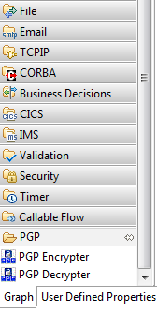
PGP SupportPac Features
Easily pluggable to IBM Integration Bus Toolkit
Once PGP SupportPac plugins is applied to the IBM Integration Bus Toolkit, PGP Encrypter/Decrypter nodes will be available in the PGP drawer of the message flow node palette.
Easy Runtime Installation
It requires standard UserDefined Node installation process. SupportPac ships with following runtime libraries (.jar files) which needs to be placed at Broker's User Lil Path.
bcpg-jdk15on-154.jar
bcprov-ext-jdk15on-154.jar
com.ibm.broker.supportpac.PGP.jar
PGP SupportPac version 1.0.0.2 for IBM Integration Bus v9

Slide 7
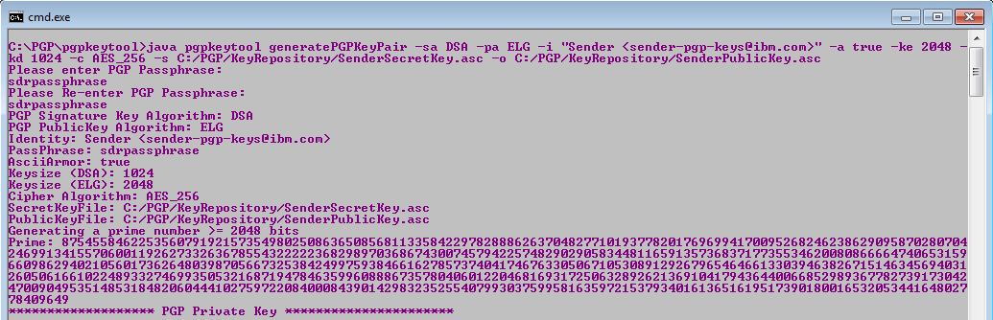
PGP SupportPac Features (continue…)
PGP key pair generation and key/repository management
This SupportPac ships with a Java based command-line tool (pgpkeytool) for PGP key generation and key/repository management.
You do not need any third-party open source or commercial tool for PGP key/repository management.
PGP SupportPac version 1.0.0.2 for IBM Integration Bus v9

Slide 8
PGP SupportPac Features (continue…)
List of operations supported by pgpkeytool
S/N | Operation | Description
1 | generatePGPKeyPair | Generate PGP Private/Public key pair.
2 | changePrivateKeyPassphrase | Change Private key passphrase.
3 | importPrivateKey | Import specified Private key into Private key Repository file.
4 | importPublicKey | Import specified Public key into Public key Repository file.
5 | exportPrivateKey | Export specified Private key from Private key Repository file into separate Private key file.
6 | exportPublicKey | Export specified Public key from Public key Repository file into separate Public key file.
7 | deletePrivateKey | Delete specified Private key from Private key Repository file.
8 | deletePublicKey | Delete specified Public key from Public key Repository file.
9 | listPrivateKeys | List all Private keys hosted by Private key Repository file.
10 | listPublicKeys | List all Public keys hosted by Public key Repository file.
11 | encrypt | Encrypt file.
12 | signAndEncrypt | Sign and encrypt file.
13 | decrypt | Decrypt encrypted file and validate signature.
PGP SupportPac version 1.0.0.2 for IBM Integration Bus v9

Slide 9
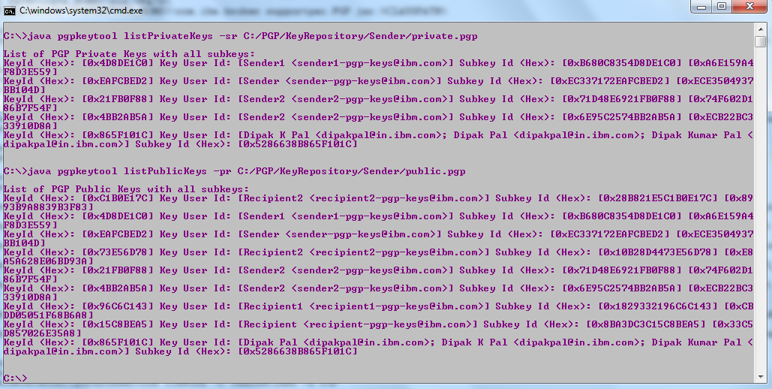
PGP SupportPac Features (continue…)
Snapshot of a key management command supported by pgpkeytool
PGP SupportPac version 1.0.0.2 for IBM Integration Bus v9

Slide 10
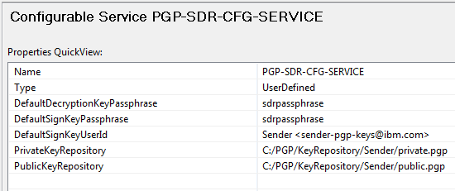
PGP SupportPac Features (continue…)
Centralized key repository and some default parameters configuration through UserDefined Configurable Service
You do not need to specify private/public key repository details, default sign key and passphrase, decryption key passphrase information at each PGP Encrypter/Decrypter node used in the messageflow.
Just create a UserDefined Configurable Service for all (or a group of messageflows) and specify the service name at node properties.
In general just one Configurable Service is sufficient for all the messageflows deployed in a Broker.
PGP SupportPac version 1.0.0.2 for IBM Integration Bus v9

Slide 11

PGP SupportPac Features (continue……)
Nodes provided by the SupportPac (PGP Encrypter Node)
PGP Encrypter Node
Provides PGP signature generation (optional) and encryption functionalities.
Supports both Message and File encryption regardless of transport protocol or message domain.
Node can be configured to write encrypted data into Output Message Tree or File System directly.
In case of File encryption, Input file can be deleted or archived (with or without timestamp suffix) after successful encryption process.
Some node properties can be overridden at node's input local environment during runtime. Node properties overridden at input local environment are applicable at current invocation of the messageflow only.
Node reads PGP private/public keys and default signature key/passphrase information configured at UserDefined Configurable Service.
PGP SupportPac version 1.0.0.2 for IBM Integration Bus v9

Slide 12
PGP SupportPac Features (continue……)
Nodes provided by the SupportPac (PGP Encrypter Node)
PGP Encrypter Node
Key information can be provided as either Key User Id (e.g. Sender <sender-pgp-keys@ibm.com>) or Hexadecimal Key Id (e.g. 0x73E56D78). OR PGP Encryption/Sign Key(s) can be set runtime at node’s InputLocalEnvironment as BLOB data.
Supports wide range of required algorithms.
Hash (Digest) Algorithms: MD5, SHA1, RIPEMD160, MD2, SHA256, SHA384, SHA512, SHA224
Cipher Algorithms: IDEA, TRIPLE_DES, CAST5, BLOWFISH, DES, AES_128, AES_192, AES_256, TWOFISH
Compression Algorithms: UNCOMPRESSED, ZIP, ZLIB, BZIP2
PGP SupportPac version 1.0.0.2 for IBM Integration Bus v9

Slide 13
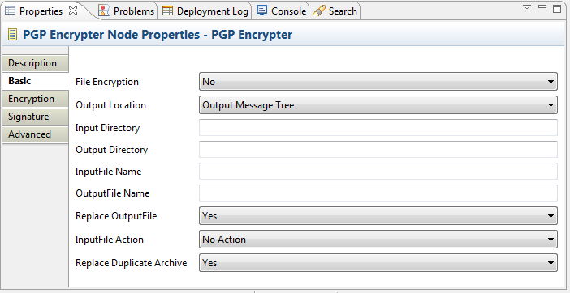
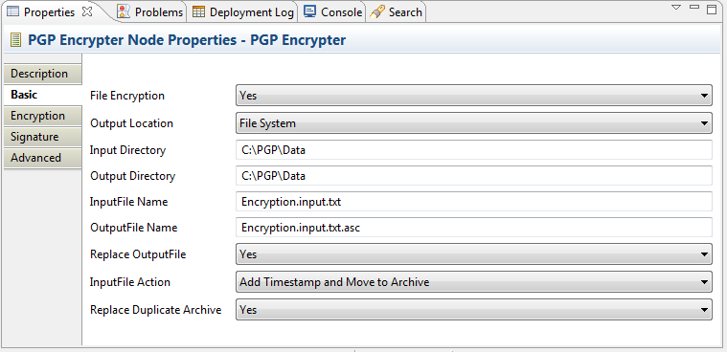
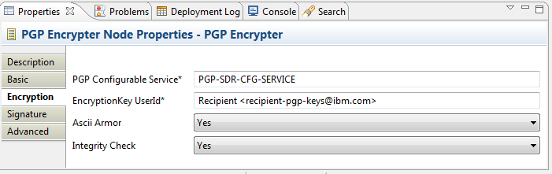
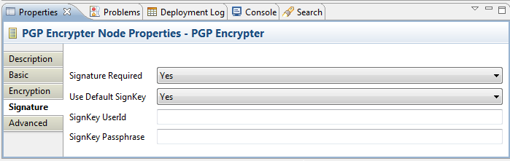
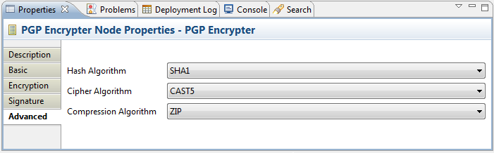
PGP SupportPac Features (continue……)
PGP Encrypter Node Properties
PGP SupportPac version 1.0.0.2 for IBM Integration Bus v9

Slide 14

PGP SupportPac Features (continue……)
Nodes provided by the SupportPac (PGP Decrypter Node)
PGP Decrypter Node
Provides PGP signature validation (optional) and decryption functionalities.
Supports both Message and File decryption.
Node can be configured to write decrypted data into Output Message Tree or File System directly.
In case of File decryption, Input file can be deleted or archived (with or without timestamp suffix) after successful decryption process.
Some node properties can be overridden at node's input local environment during runtime. Node properties overridden at input local environment are applicable at current invocation of the messageflow only.
Node reads PGP private/public keys and default decryption key passphrase information configured at UserDefined Configurable Service.
PGP SupportPac version 1.0.0.2 for IBM Integration Bus v9

Slide 15
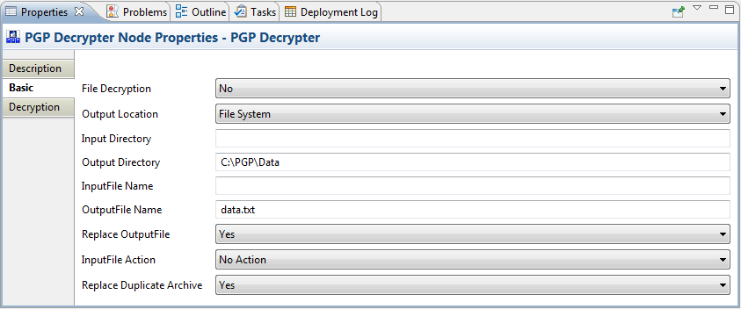
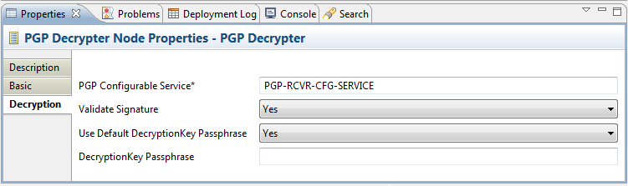
PGP SupportPac Features (continue……)
PGP Decrypter Node Properties
PGP SupportPac version 1.0.0.2 for IBM Integration Bus v9

Slide 16

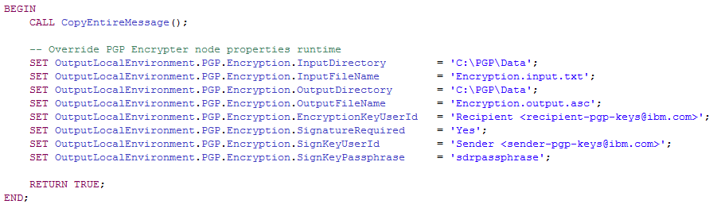
Sample MessageFlow (Encryption)
With
Node Properties Overridden at Node’s Input Local Environment
PGP SupportPac version 1.0.0.2 for IBM Integration Bus v9

Slide 17
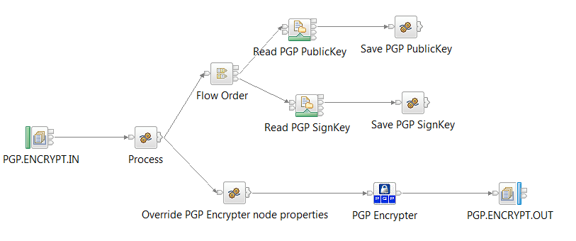
Sample MessageFlow (Encryption)
With
Set PGP Encryption/Sign Key(s) as BLOB data from File/Database
at Node’s Input Local Environment
PGP SupportPac version 1.0.0.2 for IBM Integration Bus v9

Slide 18
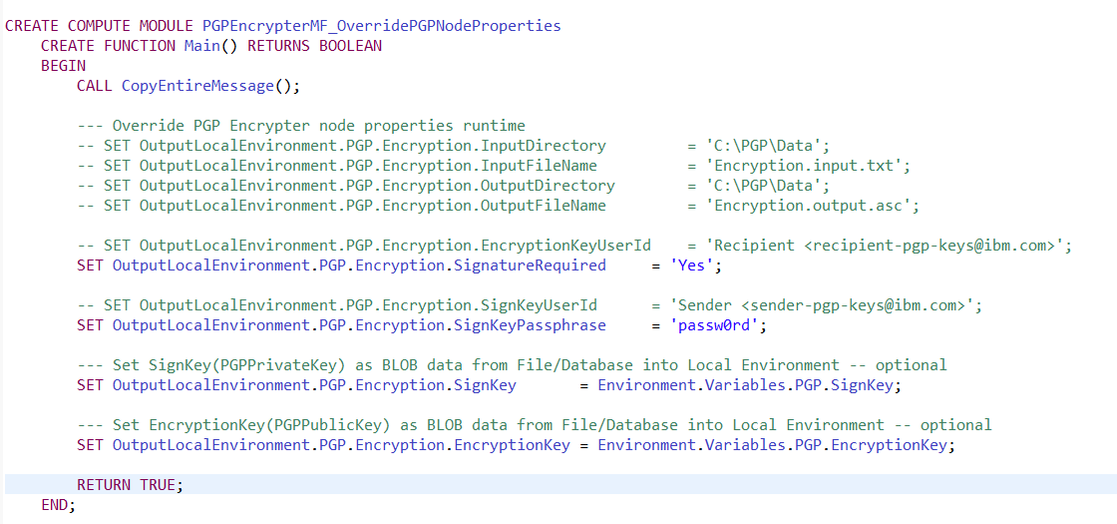
Sample MessageFlow (Encryption)
With
Set PGP Encryption/Sign Key(s) as BLOB data from File/Database
at Node’s Input Local Environment
PGP SupportPac version 1.0.0.2 for IBM Integration Bus v9

Slide 19
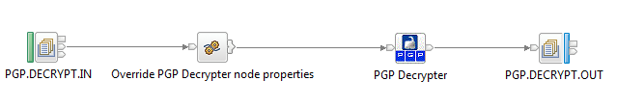
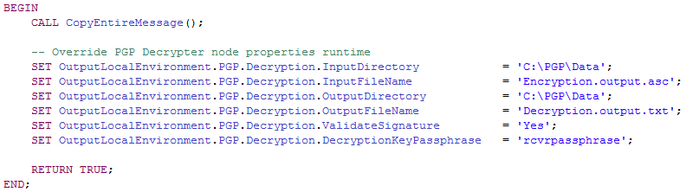
Sample MessageFlow (Decryption)
With
Node Properties Overridden at Node’s Input Local Environment
PGP SupportPac version 1.0.0.2 for IBM Integration Bus v9

Slide 20
Conclusion
This SupportPac provides application-layer security enforcing data confidentiality and integrity powered by PGP cryptographic solution.
Current version (v1.0.0.2) of this SupportPac only supports signature generation/validation integrated with encryption/decryption process.
Future version will provide isolated signature generation/validation functionalities.
Future version will provide better GUI at node properties view.
Future version of pgpkeytool will be powered by user-friendly GUI similar to IBM Key Management tool shipped with Websphere MQ.
PGP SupportPac version 1.0.0.2 for IBM Integration Bus v9

Slide 21
Resources
PGP SupportPac binary, source code, documents, samples and other artifacts are available at GitHub.
https://github.com/dipakpal/MyOpenTech-PGP-SupportPac.
Do you have any question ?
Just put your question(s) at following IBM developerWorks
public community forum.
https://www.ibm.com/developerworks/community/groups/community/pgpsupportpaciib
PGP SupportPac version 1.0.0.2 for IBM Integration Bus v9

Slide 22
Resources
PGP References
PGP Basics: PGP basic concepts.
Bouncy Castle: Bouncy Castle Resources.
Gpg4Win: PGP encryption/decryption command line and GUI tool.
Portable PGP: Java based GUI tool for PGP.
GnuPG: GnuPG PGP library.
PGP SupportPac version 1.0.0.2 for IBM Integration Bus v9

Slide 23
Thank You

